Slide 1
Project on Ratings Prediction
Salman Pradhan
Submitted by

Slide 2
These are the approaches to solve this problem
1.Understand business problem
2.Scrapping data from flipkart.com using selenium
3.Data analysis
4.Data Cleaning
5.Data preprocessing
6.Model Building
7. Model Evaluation
8. Selecting the best model

Slide 3
Scrapping Reviews and Ratings

Slide 4
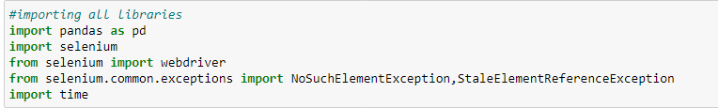
Required Libraries
These libraries are needed for data collection from flipkart.
1.Pandas
2.Selenium
3.time

Slide 5
After importing libraries we have to scrap reviews and ratings and store them in a list.
We have to scrap reviews and ratings for different technical product such as laptop,phone,printer,professional camera etc.
Later we have to make a dataframe and store data there.
And we have to concat dataframes together to make a single dataframe and store the dataframe in csv file for model building.

Slide 6
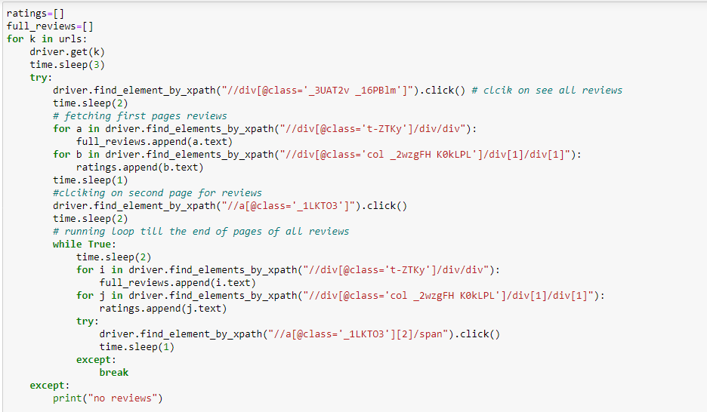

Slide 7
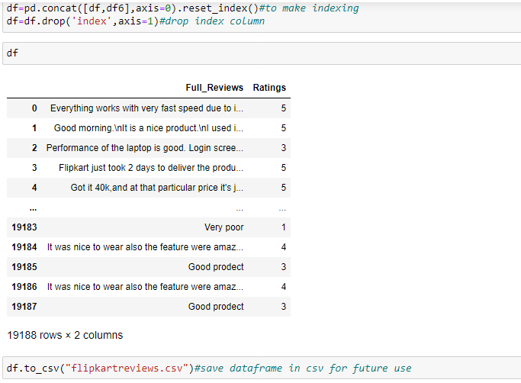

Slide 8
After we scrap data,we have to build a model which predicts ratings of reviews.

Slide 9
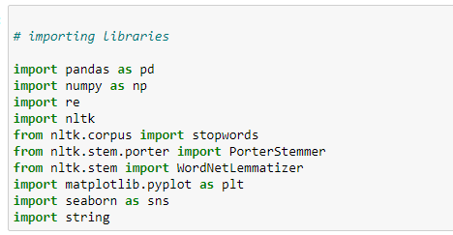
Required Libraries
1.Numpy
2.Pandas
3.Matplotlib
4.Seaborn
5.Scikit_learn
6.Nltk
7.Re
8.String

Slide 10
About Dataset
1.Loading dataset
2.Checking dimension
3.Checking columns
4.Checking column’s type
5.Statistical analysis
6.Checking Null values

Slide 11
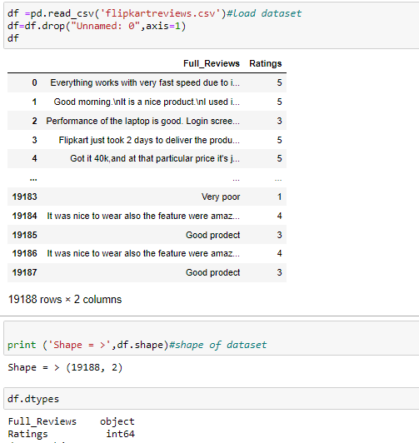
Dataset

Slide 12
From dataset we get informations as:
Dataset has so many null values.
Dataset has target variable column (Ratings).As dataset has 5 values, it is a classification problem statement.

Slide 13
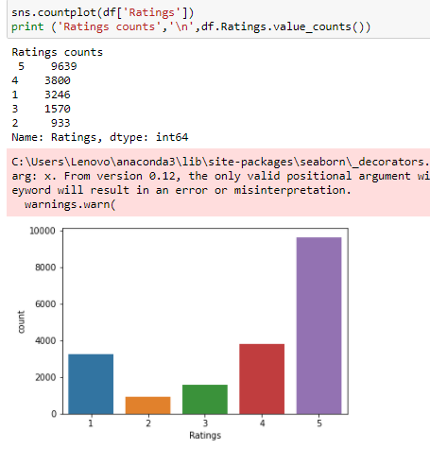
Data Analysis
It is an imbalanced dataset.

Slide 14
Data preprocessing
First we have to remove all other words and symbols except alphates (a-z and A-Z).
We have to make all the words lower.
We have to split words from different sentences.
Then we have made a list named stoplist which contains all the repetation of words whose impact is neglisible while predicting the output.
We have to remove all the punctuations that present inside the sentence.
After removing all these unnecessary noise ,we have converted words to their base form by using WordnetLemmatizer.
Almost 750000 unnecessary words are removed.

Slide 15
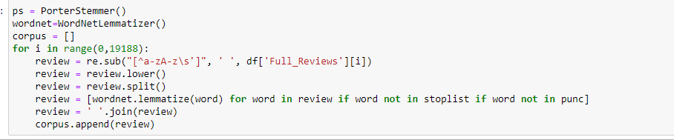
Data cleaning

Slide 16
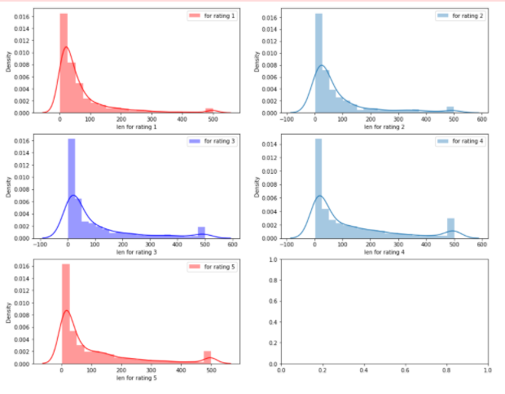
Distribution of length before cleaning

Slide 17
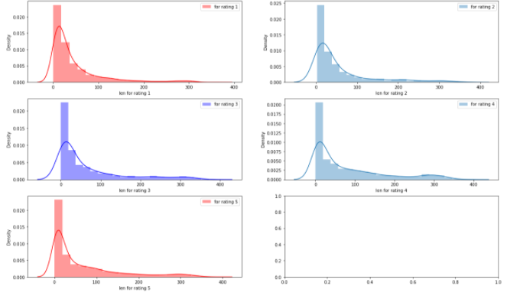
Distribution of length after cleaning

Slide 18

Convert texts to vector by using tfidfvectorizer.

Slide 19
Model building
We have to choose best random_state for our model.
We have to divide dataset in 90% training and 10% for testing purpose.
We have to use different algorithms and check it’s accuracy.

Slide 20
Algorithms used for model building:
1.MultinomialNB
2.RandomForestClassifier
3.DecisionTreeClassifier
4.LogisticRegression
5.AdaBoostClassifier
6.GradientBoostingClassifier
7.XGBClassifier
8.SVC

Slide 21
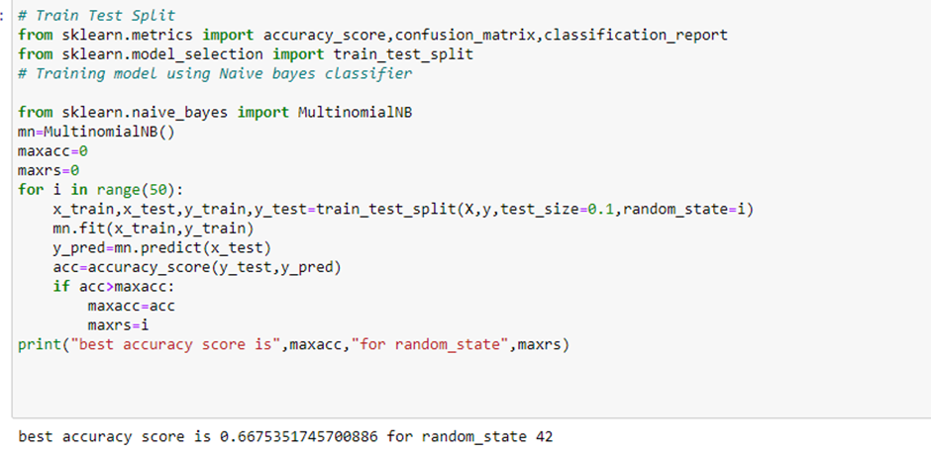

Slide 22
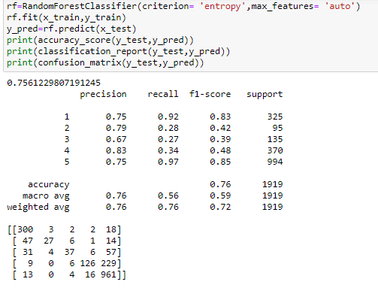
After using above algorithms we found that RandomForestClassifier is the best model for the dataset.

Slide 23
Hyperparameter Tuning of Lasso Regression
After hyperparameter tuning of RandomForestClassifier model,my accuracy score becomes 75.61% from 75%%

Slide 24
Conclusion
First we scrap Reviews and Ratings data of different technical products from flipkart.com using selenium webdriver.After scrapping,we save this dataset in a csv file named “flipkartreviews.csv”.
Then we preprocess data by cleaning duplicates,noise and unnecessary words which are not helpful for this project.
Then we convert text into vectors by using tfidfvectorizer as we know our ml model understands only integers.
We choose our best random_state.Then we build our model.
Though our dataset is imbalanced,we clearly see that f1 score of RandomForestClassifier is good compared to all other algorithms.
So we check croos_val_score of this model to check if it is overfitting or not.
We confirm and conclude that this is the best model.we hypertune it by using GridSearchCV.After hypertuning we get an accuracy score of 75.61% from 75%.
We save the model by using joblib for future use.

